Slide 1
PROJECT ON PRODUCT CLUSTER ANALYSIS
PRESENTED BY SANU MATHEW

Slide 2
TABLE OF CONTENTS
PROJECT INTRODUCTION
BUSINESS UNDERSTANDING
METHODOLOGY
DATA EXPLORATION
DATA CLEANING
FEATURE ENGINEERING
EXPLORATORY DATA ANALYSIS(EDA)
FEATURE SCALING
MODEL SELECTION
EVALUATION
VISUALIZATION(PCA)
INSIGHT GENERATION
BUSINESS RECOMMENDATION
DEPLOYMENT

Slide 3
INTRODUCTION
In today’s competitive retail and distribution landscape, understanding product performance and customer demand patterns is essential for effective decision-making. Organizations often manage a large and diverse portfolio of products, making it challenging to identify which products drive revenue, which underperform, and how demand varies over time.
In today’s competitive retail and distribution landscape, understanding product performance and customer demand patterns is essential for effective decision-making. Organizations often manage a large and diverse portfolio of products, making it challenging to identify which products drive revenue, which underperform, and how demand varies over time.
This project focuses on applying data-driven techniques to analyze historical sales data and uncover meaningful patterns in product behavior. By leveraging machine learning methods such as clustering, products are grouped based on similarities in sales performance, variability, and demand characteristics.
The analysis enables the identification of key product segments such as high-performing products, slow-moving inventory, seasonal items, and stable performers. These insights support better inventory management, improved product assortment planning, and more targeted business strategies.

Slide 4
BUSINESS UNDERSTANDING
In a competitive retail and distribution environment, organizations manage a wide range of products with varying demand patterns and performance levels. However, the lack of structured insights into product behavior often leads to challenges such as overstocking, stockouts, inefficient inventory allocation, and missed revenue opportunities.
The primary objective of this project is to gain a deeper understanding of product performance by analyzing historical sales data. Specifically, the project aims to identify patterns in product demand, distinguish between high-performing and low-performing products, and uncover variations in sales behavior over time.
By grouping products based on their sales characteristics, the business can better understand which products drive revenue, which require attention, and how different product segments behave. This enables more informed decision-making across inventory management, procurement, and sales strategy.
Additionally, the project seeks to identify relationships in product demand patterns, allowing the business to optimize product placement, improve planning, and enhance overall operational efficiency. Ultimately, the goal is to leverage data-driven insights to improve business performance and maintain a competitive advantage.

Slide 5
METHODOLOGY
The methodology for this project follows a structured data science workflow to transform raw sales data into meaningful business insights.
The process begins with data collection and understanding, where the dataset is explored to identify key variables such as product identifiers, sales metrics, and time-related features. This is followed by data cleaning, which involves handling missing values, correcting data inconsistencies, addressing negative values, and ensuring overall data quality.
The process begins with data collection and understanding, where the dataset is explored to identify key variables such as product identifiers, sales metrics, and time-related features. This is followed by data cleaning, which involves handling missing values, correcting data inconsistencies, addressing negative values, and ensuring overall data quality.
Next, feature engineering is performed to create product-level attributes that capture sales behavior. These include total sales, average sales, variability, demand intensity, channel contribution ratios, and activity levels. Log transformations are applied to reduce skewness and improve model performance.
To determine the optimal number of clusters, the Elbow Method and Silhouette Score are used. Once the model is finalized, clusters are visualized using Principal Component Analysis (PCA) for better interpretability.
Finally, clusters are analyzed and interpreted based on their characteristics, and meaningful business insights are derived to support inventory optimization, product strategy, and decision-making.

Slide 6
DATASET EXPLORATION
The dataset exploration phase focused on understanding the structure, quality, and key characteristics of the sales data. The dataset consists of product-level records including attributes such as item code, supplier, product type, and multiple sales-related variables including retail sales, warehouse sales, and total sales over time.
Initial exploration involved examining the dataset’s size, data types, and distribution of values across features. Summary statistics were used to understand central tendencies and variability in sales metrics, while checks for missing values and duplicates ensured data quality.
Further analysis revealed that the sales data was highly skewed, with a small number of products contributing disproportionately to total revenue. This indicated the presence of high-value products alongside a large number of low-performing items. Outlier detection confirmed extreme values in sales, which required careful handling in subsequent steps.
Categorical variables such as supplier and product type were analyzed to understand diversity and distribution across categories. Time-based exploration using monthly trends highlighted seasonal patterns and fluctuations in product demand
Correlation analysis showed strong relationships between retail sales, warehouse sales, and total sales, indicating consistent aggregation of sales channels. Additionally, pivot-based analysis provided insights into product performance across different time periods.
Overall, the dataset exploration phase provided critical insights into data distribution, quality issues, and underlying patterns, forming a strong foundation for effective feature engineering and clustering analysis.

Slide 7
DATASET DESCRIPTION
Descriptive statistics were used to summarize and understand the key numerical features of the dataset, particularly the sales-related variables such as total sales, retail sales, and warehouse sales. These statistics provide insights into the central tendency, variability, and distribution of the data.
The analysis revealed that the sales variables exhibit a high degree of variability, with a significant difference between minimum and maximum values. The mean values were notably higher than the median values, indicating a right-skewed distribution where a small number of products contribute disproportionately to total sales.
Standard deviation values were relatively high, reflecting considerable dispersion in product performance across the dataset. This suggests that product demand is not uniform and varies significantly between high-performing and low-performing items.
Additionally, the presence of extreme values and outliers was observed, further emphasizing the uneven distribution of sales. These characteristics justified the application of log transformation during preprocessing to normalize the data and improve model performance.
Overall, descriptive statistics provided a foundational understanding of data distribution, variability, and skewness, guiding subsequent steps in data cleaning, feature engineering, and clustering analysis.

Slide 8
DATA CLEANING
The data cleaning phase focused on improving data quality and ensuring consistency across all features before analysis and modeling. Initially, the dataset was examined for missing values, incorrect data types, and duplicate records.
Missing values in categorical variables, such as product type, were handled through appropriate imputation, while numerical inconsistencies were carefully reviewed. Duplicate records were identified and removed to avoid redundancy and bias in the analysis.
A key data quality issue involved negative values in warehouse sales, which were identified as potential returns or stock adjustments. These values were handled by capping them at zero and creating an additional feature to capture return behavior, ensuring that the transformation preserved business meaning.
Further validation confirmed that total sales were a combination of retail sales, retail transfers, and warehouse sales. This ensured logical consistency across the dataset.
Additionally, the sales data exhibited significant skewness and the presence of outliers. To address this, log transformations were applied to normalize the distribution and reduce the impact of extreme values.
Finally, text fields such as supplier and product type were standardized to maintain uniformity and avoid duplication due to formatting inconsistencies. The cleaned dataset was validated to ensure completeness and accuracy, making it suitable for feature engineering and clustering analysis.

Slide 9
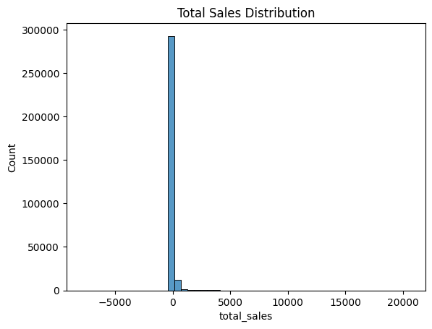
TOTAL SALES DISTRIBUTION
Observations:
Heavy Right Skew- Majority of products have low sales
Few products dominate revenue
Presence of Outliers- Extreme high values strect the distribution
Negative Values- Sales should not usually be negative
If data is skewed, Large values dominate clustering, Small products get ignored
To fix this, I applied the following steps
Handle Negative Values - It represent reverse transactions, not actual demand
Apply Log Transformation - To reduce skewness, Control Outliers and
to have better grouping of clusters
Handle Outliers- Dominance of large values leads to misleading patterns
and poor model performance
Rebuild features using Transformed data-transformed messy sales data into structured signals that ML can actually understand

Slide 10
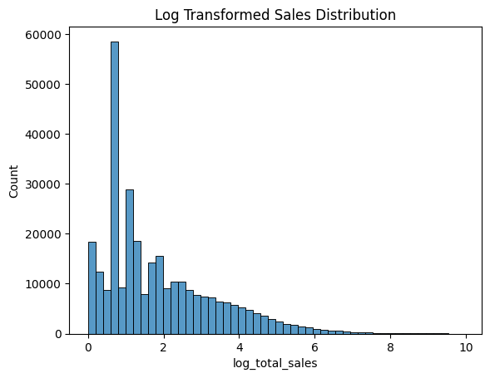
LOG TRANSFORMED SALES DISTRIBUTION
Key Observations from Log-Transformed Distribution
Skewness is greatly reduced; distribution is much more spread out and shape
is closer to normal(bell-like)
Better Data Spread- Values now range between 0 to 10. Differences between
products are now visible and comparable
Dense Region Around 1-3. Most data points lie between log values 1 to 3.
Majority of your products are still low performers (expected in retail)
Long Tail Still Exists (But Controlled).
High-performing products still exist. But they no longer dominate the dataset
Outliers Are Now Managed. Model will treat all data more fairly

Slide 11
FEATURE ENGINEERING
The feature engineering phase focused on transforming raw sales data into meaningful product-level attributes that capture different aspects of product behavior. Since the dataset contained transactional records over time, the data was aggregated at the product level to enable effective clustering.
Key features were created to represent overall demand, including total sales, average sales, and sales variability. These features help distinguish between high-performing and low-performing products, as well as identify fluctuations in demand.
To capture demand intensity and product activity, additional features such as sales per month and active months were introduced. These metrics provide insights into how frequently a product is sold and its lifecycle behavior.
Channel contribution was analyzed by creating ratio-based features such as retail sales ratio and warehouse sales ratio, which indicate the relative importance of different sales channels for each product.
A seasonality indicator was also developed using the coefficient of variation, allowing the identification of products with stable versus fluctuating demand patterns. Additionally, a returns-related feature was included to capture negative adjustments in warehouse sales, preserving important business signals.
To address skewness in sales data, log transformations were applied to key numerical features, improving data distribution and enhancing clustering performance.
Overall, feature engineering enabled the creation of a comprehensive product behavior profile, significantly improving the effectiveness and interpretability of the clustering model.

Slide 12
The following features were engineered at the product (item_code) level to capture demand, variability, and behavior patterns:
1. Total Sales (Demand)-Total Sales of a product across all periods Total_Sales_Sum = Sum of total_sales for each product
2. Average Sales (Typical Performance)- Average Sales per time perod for a product Total_Sales_Avg = Total_Sales_Sum / Number of records for that product
3. Sales Variability (Demand Fluctuation)- How much sales fluctuate over time Sales_Variability = Standard deviation of total_sales for each product
4. Active Months (Product Lifecycle)- Number of unique months in which a product had sales Active_Months = Number of unique months in which the product appears
5. Sales per Month (Demand Intensity)-Average monthly sales of a product, representing how frequently and strongly it sells. Sales_Per_Month = Total_Sales_Sum / (Active_Months + 1)
6. Retail Contribution Ratio- Proportion of total sales generated through the retail channel Retail_Ratio = Retail_Sales_Sum / (Total_Sales_Sum + 1)
7. Warehouse Contribution Ratio- Proportion of total sales contributed by warehouse transactions Warehouse_Ratio = Warehouse_Sales_Sum / (Total_Sales_Sum + 1)

Slide 13
8. Seasonality Indicator (Variability Index)- Measures how much a product’s sales fluctuate over time, indicating stability or seasonality CV_Sales = Sales_Variability / (Total_Sales_Avg + 1)
9. Returns Indicator- Capture the number of instances where products experienced negative warehouse sales(returns or adjustments) Total_Returns = Count of instances where warehouse_sales < 0
10. Log Transformation (Skewness Handling)- Reduces Skewness in data by compressing large values to improve model performence Log_Value = log(1 + Feature_Value)
Applied to:
Total_Sales_Sum
Retail_Sales_Sum
Warehouse_Sales_Sum
Sales_Per_Month
11. Activity Flag- Indicates whether a product is actively sold across multiple months or not Is_Active = 1 if Active_Months > 6, else 0
Finally 5 important Features were kept in for model training- Sales_per_month, cv_sales, retail_ratio, warehouse_ratio, active_months
These features collectively represent product demand, stability, channel contribution, and lifecycle behavior.

Slide 14
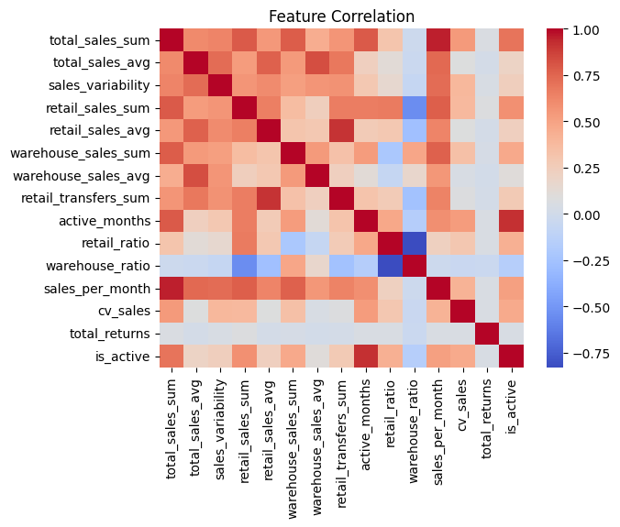
FEATURE CORRELATION HEATMAP
Sales Features Are Highly Correlated
total_sales_sum ↔ retail_sales_sum → High positive
total_sales_sum ↔ warehouse_sales_sum → High positive
total_sales_sum ↔ sales_per_month → Very high
Represent overall demand
May introduce redundancy
These features are capturing the same demand signal
High sales products perform consistently across channels
sales_per_month is a strong indicator of product performance
2. Channel Ratios Provide Strong Differentiation
retail_ratio ↔ warehouse_ratio → Strong negative (~ -0.7 to -0.8)
If retail share increases → warehouse share decreases
Retail vs Warehouse clearly separates products
3. Variability Captures Seasonality
cv_sales has low/moderate correlation with total sales
Some products are High sales with stable variability , while others are High sales with volatility
Independent of sales volume
Important for clustering for seasonal products

Slide 15
4. Product Activity Drives Revenue
active_months ↔ total_sales_sum → Strong positive
Products sold more months → higher total sales
More active months → higher sales
5. Returns Are Independent Signal
Useful for identifying problematic products . Weak correlation with most features
Returns are independent behavior. Returns do not directly depend on sales volume
It indicate Quality issues or Logistical problems
6. is_active Feature
Strong correlation with active_months and Sales features. Active products = higher sales
Active inventory drives business, Inactive products = dead stock
Correlation analysis revealed strong relationships among sales-related features, indicating redundancy in demand metrics. Channel contribution ratios showed strong inverse relationships, providing clear differentiation between retail-driven and warehouse-driven products. Variability and returns emerged as independent features, capturing unique aspects of product behavior.

Slide 16
EXPLORATORY DATA ANALYSIS(EDA)
The exploratory data analysis phase focused on understanding the structure, distribution, and underlying patterns within the dataset to guide subsequent modeling steps.
Initial analysis involved examining the dataset structure, data types, and data quality to ensure readiness for analysis. Summary statistics were used to evaluate central tendencies and variability in key numerical features such as total sales, retail sales, and warehouse sales.
The distribution of sales data revealed a highly right-skewed pattern, indicating that a small number of products contribute significantly to overall revenue, while the majority of products have relatively low sales. This insight highlighted the need for data transformation techniques to normalize the distribution.
Outlier analysis further confirmed the presence of extreme values in sales variables, reinforcing the importance of handling skewness to prevent bias in clustering results. Log transformation was applied to key features to reduce skewness and improve model performance.
Categorical analysis of variables such as supplier and product type provided insights into product diversity and category-wise contributions. Supplier-level analysis showed that a few suppliers dominate total sales, while product-type analysis revealed varying demand across categories such as wine, liquor, and beer.

Slide 17
Time-based analysis using monthly trends helped identify seasonal patterns and fluctuations in product demand. Some products exhibited consistent demand across months, while others showed significant variability, indicating seasonal behavior.
Correlation analysis revealed strong relationships among sales-related features, indicating redundancy in certain variables, while ratio and variability features provided better differentiation for clustering.
Overall, the EDA phase provided critical insights into data distribution, feature relationships, and demand patterns, forming a strong foundation for effective feature engineering and clustering analysis.

Slide 18
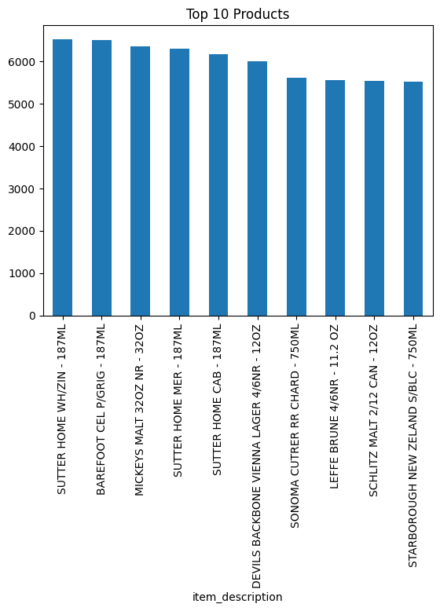
Top Products
SUTTER HOME dominates with multiple SKUs (White Zin, Merlot, Cabernet)
187ML pack size products are the highest revenue contributors
Indicates strong demand for small, convenient packaging
High sales from budget-friendly brands (Sutter Home, Barefoot)
Customers show price-sensitive purchasing patterns
Preference for affordable wines with consistent quality
Products like Mickey’s Malt & Schlitz Malt show strong performance
Larger pack sizes indicate bulk consumption behavior
Beer segment contributes to steady and repeat sales
Premium wines (Sonoma Cutrer, Starborough) are in top sellers
Reflects presence of high-value customer segment
Lower volume but higher revenue per unit
Business Recommendation:
Increase stock for fast-moving 187ML wine bottles
Focus on budget segment for volume growth
Promote premium products via targeted campaigns
Expand craft & imported beverage portfolio
Introduce bundled offers to increase basket size

Slide 19
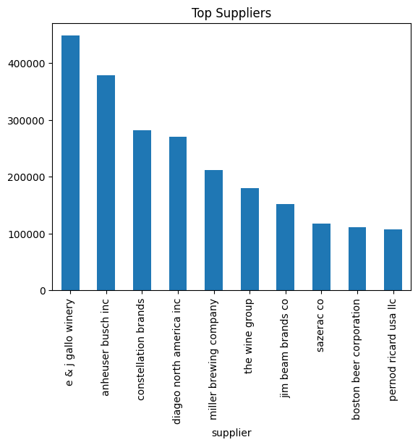
Top Suppliers
E & J Gallo Winery is the leading supplier with the highest sales contribution
Anheuser-Busch Inc and Constellation Brands follow as major contributors
Top 3 suppliers dominate a significant share of total sales
Strong presence of wine-focused suppliers in top positions
Mix of beer, wine, and spirits suppliers indicates a diversified portfolio
Mid-tier suppliers (Diageo, Miller Brewing) show consistent performance
Business Implications:
High dependency on few key suppliers (risk + opportunity)
Opportunity to strengthen partnerships with top suppliers
Scope to improve performance of lower-tier suppliers
Recommendations:
Focus on top supplier relationship management
Negotiate better deals with high-volume suppliers
Diversify supplier base to reduce dependency risk

Slide 20
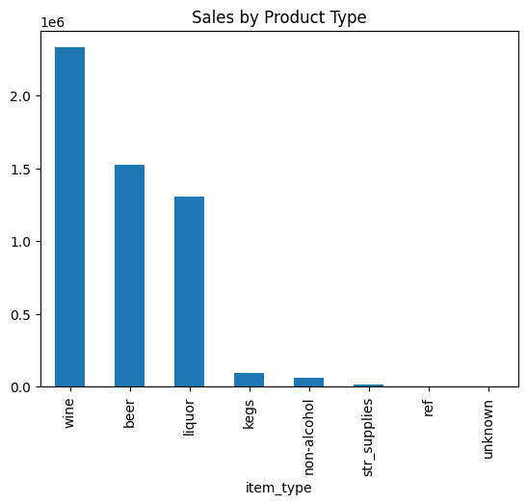
Sales by Product Type
Wine is the top-selling category with the highest revenue contribution
Beer ranks second, showing strong and consistent demand
Liquor holds the third position with significant sales share
Top 3 categories (Wine, Beer, Liquor) dominate overall sales
Wine significantly outperforms other categories → primary revenue driver
Beer & Liquor indicate stable and recurring consumption patterns
Kegs & Non-Alcoholic products contribute minimal sales
Str Supplies, RFT, Unknown categories have negligible impact
Indicates low demand or niche usage segments
Business Implications:
Heavy reliance on alcoholic beverage categories
Opportunity to optimize or rationalize low-performing categories
Focus on high-margin categories (Wine & Liquor)
Recommendations:
Increase focus on Wine portfolio expansion
Strengthen Beer & Liquor promotions for volume growth
Evaluate strategy for low-performing categories (reduce / reposition)

Slide 21
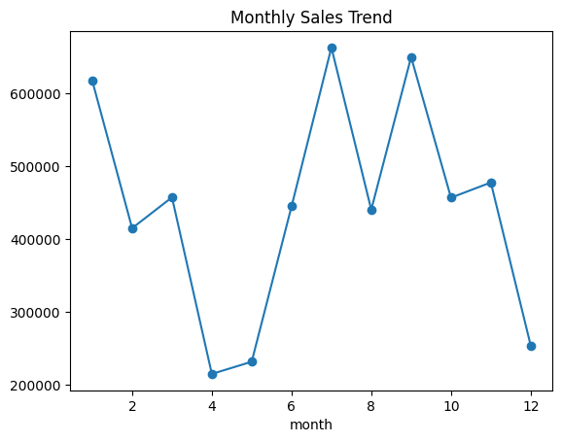
Monthly Sales Trend
Sales show significant fluctuations across months
Peak sales observed in Month 7 and Month 9
Lowest sales recorded in Month 4 and Month 12
Strong recovery after mid-year dip (Month 4–5 → Month 7 peak)
Indicates seasonal demand patterns
Sales remain relatively stable in the second half with periodic spikes
Business Implications:
Demand is not uniform → requires seasonal planning
Peak months contribute major share of annual revenue
Low months indicate opportunity for demand generation strategies
Recommendations:
Increase inventory & marketing before peak months (7 & 9)
Introduce discounts/offers during low months (4 & 12)
Plan seasonal campaigns aligned with demand cycles

Slide 22
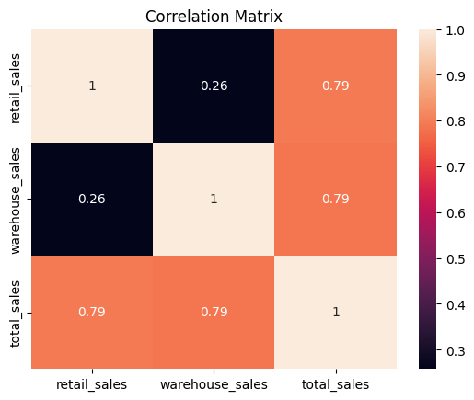
Correlation Matrix
Total Sales has a strong positive correlation with:
Retail Sales (0.79) & Warehouse Sales (0.79)
Retail vs Warehouse Sales show low correlation (0.26)
Indicates both channels operate independently
Each contributes uniquely to total sales
Business Implications:
Growth in either retail or warehouse sales will increase total sales
Opportunity to optimize both channels separately
Low overlap reduces risk of channel dependency
Recommendations:
Develop separate strategies for retail & warehouse channels
Invest in both channels to maximize total revenue
Monitor channel performance independently for better decision-making

Slide 23
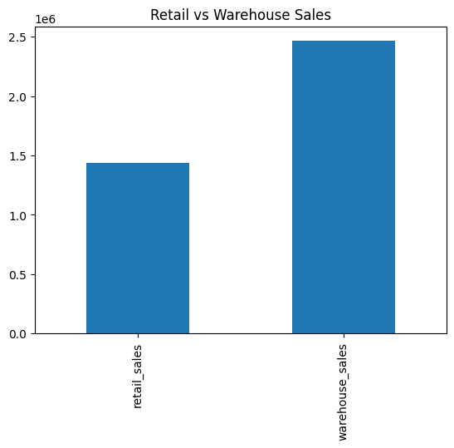
Retail vs Warehouse Sales
Warehouse Sales significantly higher than Retail Sales
Warehouse contributes the major share of total revenue
Retail sales are comparatively lower but still important
Warehouse channel indicates bulk purchasing behavior
Retail reflects individual / smaller transactions
Strong reliance on warehouse distribution model
Business Implications:
Business is heavily dependent on warehouse sales
Retail channel has untapped growth potential
Balanced channel growth can reduce dependency risk
Recommendations:
Strengthen warehouse partnerships for volume growth
Improve retail marketing & customer engagement
Explore strategies to boost retail sales performance

Slide 24
Feature Scaling
Feature scaling was performed to standardize the numerical features before applying the clustering algorithm. Since the dataset contained variables with different scales—such as total sales values in thousands and ratio-based features between 0 and 1—it was essential to normalize the data to ensure fair contribution from all features.
The StandardScaler technique was used to transform the data by centering each feature around zero and scaling it to unit variance. This process ensures that features with larger magnitudes do not dominate the distance calculations used in the K-Means clustering algorithm.
By applying feature scaling, all variables were brought to a comparable range, improving the stability and performance of the clustering model. This step was critical in ensuring that the clustering results were driven by meaningful patterns rather than differences in feature scales.
Overall, feature scaling enhanced the effectiveness of the model by enabling accurate grouping of products based on their behavioral characteristics.

Slide 25
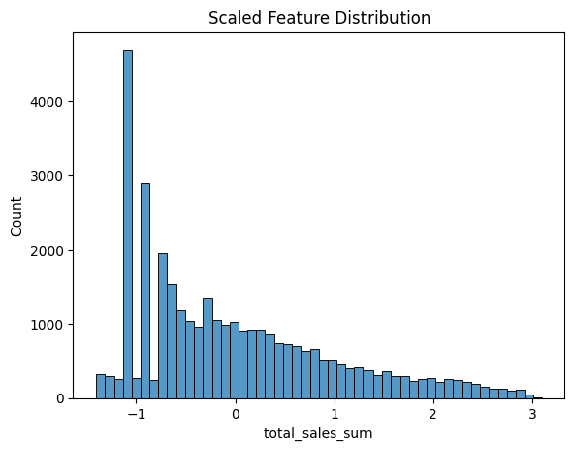
Scaled Feature Distribution
The distribution of the scaled total sales feature shows that the data has been successfully standardized, with values centered around zero and spread across a normalized range.
Despite scaling, the distribution retains a slight right skew, indicating that a subset of products still exhibits higher sales compared to the majority. This reflects the inherent business reality where a few products contribute significantly to overall revenue.
The scaling process ensures that this feature is now comparable with other variables, allowing it to contribute effectively and fairly in the clustering model without dominating due to its original magnitude.

Slide 26
Models Used in Products Clustering
K-Means Clustering (Primary Model)
Partition-based clustering algorithm
Groups products into K clusters based on similarity
Works well with numerical and scaled data
Efficient and scalable for large datasets
Agglomerative Clustering (Hierarchical Model)
Bottom-up hierarchical clustering approach
Starts with individual points and merges clusters step-by-step
Captures complex relationships in data

Slide 27
No need for centroid assumptions
Used for validation and comparison
DBSCAN (Density-Based Clustering)
Groups data based on density of points
Identifies noise and outliers automatically
Does not require predefined number of clusters

Slide 28
Hyperparameter Tuning
Optimize clustering performance, Improve cluster separation and compactness
Used Silhouette Score as evaluation metric
Adopted a minimal and efficient tuning approach
Focused only on critical hyperparameters
Reduced search space to ensure faster computation
K-Means Hyperparameters
Parameters Tuned
Number of Clusters (K): Tested values from 2 to 5 and Selected based on highest silhouette score
Parameters Fixed
Init: k-means++(optimized centroid initialization)
n_init: 10(ensures stable result)
max_iter: 300(default, sufficient for convergence)

Slide 29
Agglomerative Clustering:
Parameters Tuned: Number of Clusters tested values from 2 to 5
Parameters Fixed: Linkage Method: ward(minimizes variance within clusters)
DBSCAN:
Parameters Tuned: eps (neighborhood distance): [0.5, 1.0, 1.5]
min_samples: fixed at 5
Key points:
Minimal tuning ensures fast and scalable pipeline
Over-tuning had been performed but it led to high computation time and RAM crashes.
Model selection driven by performance + interpretability
Focused on most impactful parameters, ensuring optimal performance while maintaining computational efficiency

Slide 30
Final Model Selection
Model Performance:
K-Means: ~0.46
Agglomerative:~0.45
DBSCAN: -1(invalid clustering)
Selection criteria: Highest Silhouette score, Clear Cluster separation(PCA Visualization)
Computational efficiency and scalability
Business interpretability
Final Model Chosen: K-Means Clustering(K=2) Provided best balance of Performance,Speed and Simplicity
Key Outcome: Identified 2 distinct product segments:
Low/Moderate Demand Products
High Demand Products

Slide 31
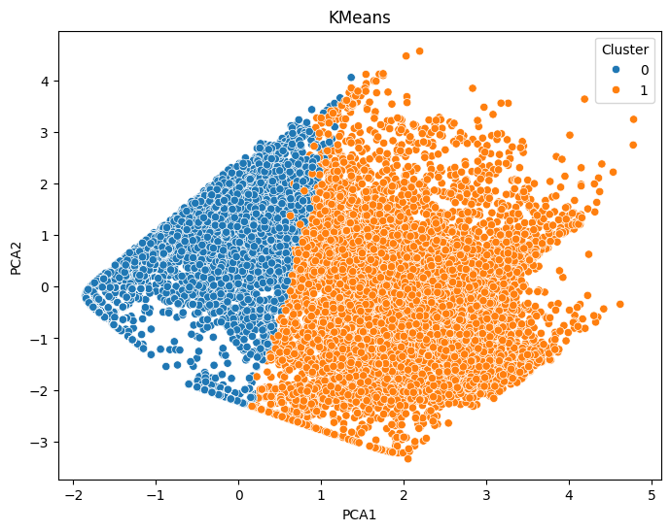
PCA Based Cluster Visualization
Applied Principal Component Analysis (PCA) to reduce high-dimensional data into 2 dimensions
Enables visual interpretation of clusters
Preserves maximum variance in data
Key Observations:
Clear Separation between two clusters
Distinct grouping along the PCA1 axis
Minimal overlap between clusters indicates strong cluster quality
Cluster Distribution:
Cluster 0 (Left Side)
Represents low to moderate demand products
More compact and dense distribution
Cluster 1(Right Side)
Represents high demand products
Wider spread indicating variability
Interpretation:
PCA Confirms that the clustering model has successfully:
Identified distinct product segments & meaningful patterns in sales

Slide 32
Business Recommendation
Inventory Optimization:
Maintain higher stock levels for high-demand products (Cluster 1)
Avoid overstocking of low-demand products (Cluster 0)
Implement data-driven inventory planning
Product Portfolio Strategy
Focus on expanding high-performing product categories
Re-evaluate or phase out consistently low-performing products
Introduce targeted product bundles to improve low-demand sales
Sales & Marketing Strategy
Allocate more marketing budget to high-demand products
Use promotions and discounts to boost low-demand items
Personalize campaigns based on product cluster behavior

Slide 33
Supplier & Procurement Planning
Prioritize procurement for fast-moving products
Optimize supplier relationships for high-demand categories
Reduce procurement frequency for slow-moving inventory
Demand Forecasting & Planning
Use cluster insights to improve demand forecasting accuracy
Plan seasonal inventory based on product behavior patterns
Enable proactive decision-making
Operational Efficiency
Streamline warehouse operations based on product movement patterns
Reduce storage and holding costs for low-performing products
Improve overall supply chain efficiency

Slide 34
Model Deployment using Streamlit (Spyder)
Deployment Objective
Convert clustering model into an interactive web application
Enable real-time product classification
Make solution accessible to non-technical users
Tools Used for Deployment
Model deployment code in Spyder
Model and scaler saved using joblib
Streamlit app created in separate Python script (app.py)
Key Features of the App
User inputs product features: Sales of the month, Variability(CV), Retail & Warehouse Ratio & Active Months
Predicted: Low/Moderate Demand Cluster or High Demand Cluster
App is executed using terminal command streamlit run app.py
Automatically launches in browser - http://localhost:8501

